Slide 1
HTML Primer

Slide 2
http://www.w3schools.com/html/html_intro.asp
A very good set of tutorials and references for HTML
“Try it” feature lets you type in HTML and see what it would look like in a browser

Slide 3
Marking Up with HTML
HTML is Hypertext Markup Language
  Notation for specifying Web page content and formatting
Hidden tags describe how words on a page should look
  Called the “mark up”, gives font, size, color, bold, indenting, etc.
Formatting with Tags:
  Words or abbreviations enclosed in angle brackets < >
  Come in pairs (beginning and end):
    <title> </title>
  Tags are not case-sensitive, but the actual text between tags is

Slide 4
Tags for Bold, Italic, and Underline
Bold: <b> </b>
Italic: <i> </i>
Underline: <u> </u>
  Tag pair surrounds the text to be formatted
You can apply more than one kind of formatting at a time
<b><i>Veni, Vidi, Vici!</i></b> produces: Veni, Vidi, Vici!
  Tags can be in any order, but have to be nested correctly
Some tags do not surround anything, so they don't have an ending form.
  <hr> inserts a horizontal rule (line)
  <br> inserts a line break

Slide 6
A Basic HTML Web Page
Begins with <html> and ends with </html>
<html>
<head>
<!– Preliminaries go here, including title -->
<title> Starter Page </title>
</head>
<body>
<!-- Main visible content of the page goes here -->
<p> Hello, World! </p>
</body>
</html>

Slide 7
Gather Your Tools
For making Web pages you need two tools
  Web browser (like FireFox)
  Simple text editor (like NotePad)
We will write HTML as plain ASCII text (not in Word or some document processor that adds information to the content)
Now use the text editor to make a file containing the basic HTML Web page source (shown previously, you can cut and paste, or type it)

Slide 8
Displaying the HTML Source File
Save this text in a file named something like “starterPage.html”
Open your web browser and have it load in the file “starterPage.html” and you will see the basic web page displayed
  “.html” file name extension means you can double-click the file and it will open in a browser
Save this basic page as a template, or a model
  you can use it to start all your future web pages

Slide 9
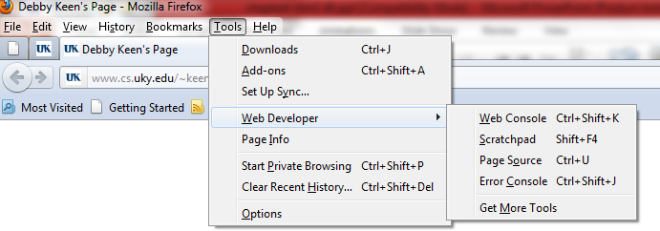
How to see the source code
To see the source code of a web page, in the newest Firefox - use Tools, Web Developer, Page Source

Slide 10
Structuring Documents
Markup language describes how a document's parts (paragraphs, headings, etc.) fit together
Headings:
  Choice of eight levels of heading tags to produce headings, subheadings, etc.
  Headings display material in large font on a new line
  <h1>Pope</h1> <h2>Cardinal</h2> <h3>Archbishop</h3>
  produces:
  Pope
  Cardinal
  Archbishop

Slide 12
HTML Format vs. Display Format
HTML text was run together on one line, but displayed on separate lines in the browser
HTML source tells the browser how to produce the formatted image based on the meaning of the tags, not on how the HTML source looks
But HTML is usually written in a structured (indented) form to make it easier to understand
  <h1>Pope</h1>
  <h2>Cardinal</h2>
  <h3>Archbishop</h3>

Slide 13
White Space
  Both HTML heading examples end up formatted the same… how?
White space is inserted in HTML for readability
  spaces, tabs, new lines
Browser turns any white space sequence in the HTML source into a single space before processing the mark up tags
  Exception: Preformatted information between
  <pre> and </pre> tags is displayed as it appears

Slide 14
Brackets in HTML: The Escape Symbol
What if our web page needed to show a math relationship like
    0 < p > r
The browser would interpret < p > as a paragraph tag, and would not display it
To show angle brackets, use escape symbol ( & ), then an abbreviation, then a semicolon ( ; )
    &lt; displays as <
    &gt; displays as >
    &amp; displays as &
So the HTML would be <i>0&lt;p&gt;r</i>

Slide 16
(Aside) Growing Good HTML
Before we go further, let’s discuss getting your HTML source files written correctly (good syntax) and well (good style)
The slow-n-steady construction strategy
  Start with a good page (like the template we saved), add tags and content in small amounts, then save and test (check it in a browser) early and often
Grow the code… don’t try to write a monolith

Slide 17
Marking Links With Anchor Tags
There are two sides of a hyperlink:
Anchor text (the highlighted text in the current document… the part you click on)
Hyperlink reference (the URL address of a Web page the link “goes to”, the target of the link)
    Begin with <a followed by a space
    Give the link reference using href="filename"
    Close the start anchor tag with >
    Text to be visibly displayed for this link
    End anchor tag with </a>

Slide 18
Examples of Anchor Tags
Bertrand
<a href=“http://www.bioz.com/bios/sci/russell.html”>
Russell</a>
  displays as
  Bertrand Russell
See
<a href=“http://help.bigCo.com/manual.html”> the manual</a> please.
  displays as
  See the manual please.

Slide 19
Anchor Tags (cont'd)
Absolute pathnames: Reference pages at other web sites using complete URLs
  http://server/directory_path/filename
<a href="http://www.aw.com/snyder/index.html">FIT</a>
Full URL is needed because the page is remote and the web server needs to be told exactly where to find it in the file system

Slide 20
Anchor Tags (cont'd)
Relative pathnames: Reference pages stored in the same directory (give only the name of the file) or in a directory organized near the current
  Read <a href="./filename">this file</a>.
Relative pathnames are more flexible — we can move web files around as a group
Relative pathnames can also specify a path deeper or higher in the directory structure
  ./subdir/filename ../subdir/filename
    . Current directory, then down
    .. Parent directory (one level up)

Slide 21
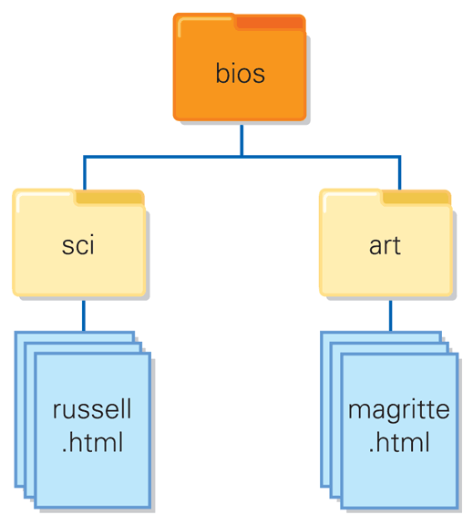
If we are at file
bios/sci/russell.html
then the source file for Magritte
can be designated with
relative path
../../art/magritte.html
The “../../” part say to go up two levels (directories)

Slide 22
Watch out for misleading tags!
<a href="http://badguy.com">
good guy.com </a>
shows up as good guy.com but when you click on it, takes you to badguy.com ! Look at the source to really know where the link points.
Phishing!! Usually to steal your identity!

Slide 23
Watch out for misleading tags!
<a href="http://badguy.com">
good guy.com </a>
shows up as good guy.com but when you click on it, takes you to badguy.com ! Look at the source to really know where the link points.

Slide 24
Be aware of case
Some operating systems (like Unix and Linux) care about whether you use upper or lower case letters.
If you need a path to a file like
"http://cs.uky.edu/~keen"
then "http://CS.UKY.edu/~Keen" will not work!

Slide 25
Showing Pictures: The Image Tags
Image Tag Format:
  <img src="filename" alt=“description" />
  src short for source
  alt gives text to print when image can’t be shown (can be used by assistive tools like audio screen readers too)
  Absolute and relative pathname rules apply
This tag will cause an image simply to be displayed on the Web page

Slide 26
“Clickable” Pictures = Thumbnail
Pictures can be used as links by combining <img> tag with an anchor tag
  <a href="fullsize.jpg">
  <img src="thumbnail.jpg" /> </a>
Here, the <img …> picture becomes the “hot spot” for the anchor tag (rather than text)
  The browser will display the picture “thumbnail.jpg” then allow the user to click on the picture as a link to the file “fullsize.jpg”

Slide 27
How to make a Thumbnail
Choose an image file (any type) to act as the “clickable link” image.
If it’s fairly small already, you are ready to use it as the thumbnail, described in the previous slide.
If it’s a big image, you can shrink it by loading it into a graphics editor or something like MS Paint.
In Paint, there is a Resize option on the main menu, choose the percentage you want to reduce the picture.
Save the image – under a different name if you want to preserve the original image.
Use the reduced-size image as your thumbnail as in previous slide

Slide 28
Including Pictures With Image Tags
GIF and JPEG Images
  GIF: Graphic Interchange Format
    8 bits (256 colors or levels of gray)
    PNG is a newer form
  JPEG: Joint Photographic Experts Group
    24 bits (millions of colors, compression levels)
  Tell browser which format image has using filename extension (.gif, .png, .jpg, .jpeg)

Slide 29
Attributes in HTML
Properties such as text alignment require more information than we have so far given
  For justification, we specify left, right, or center
Attributes appear inside the angle brackets of start tag, after tag word, with equal sign, value in double quotes.
    <p align="center"> (default justification is left)
Horizontal rule attributes: width and size (thickness) can be specified or left to default
  <hr width="50%" size="3" />

Slide 30
Attributes for Image Tags
Displayed image size can be adjusted (no matter the actual size of the raw image)
  <img src=“puffer.jpg” width=“200” height=“200” />
  Will make an image 200x200 pixels, even if the file “puffer.jpg” is 2400x2400 pixels (for example)
If you leave out one dimension attribute the browser will display the missing one to match the same proportions as the original image

Slide 31
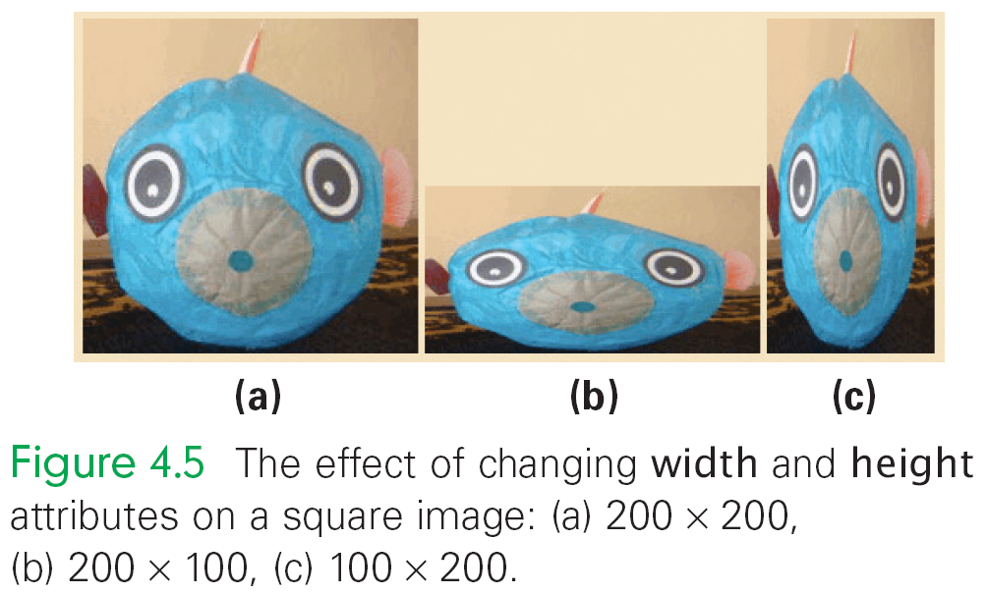
Attributes for Image Tags
Browser will do as told, even to the point of distorting images (original is 2400x2400 square)
    <img src=“puffer.jpg” width=“200” height=“200” />
    <img src=“puffer.jpg” width=“200” height=“100” />
    <img src=“puffer.jpg” width=“100” height=“200” />

Slide 32
Handling Lists
Unnumbered (bulleted) list:
  <ul> and </ul> tags begin and end the list
  <li> and </li> tags begin and end the items within the list
Ordered (numbered) list:
  <ol> and </ol> tags begin and end the list
  Uses the same <li> tags
Sublists: Insert lists within lists (between <li> </li> tags)

Slide 33
Example (Nested Lists)
<ol> <li> Hydrogen, H, 1.008, 1 </li>
<li> Helium, He, 4.003, 2 </li>
<ul> <li> good for balloons </li>
<li> makes you talk funny </li> </ul>
<li> Lithium, Li, 6.941, 2 1 </li>
<li> Beryllium, Be, 9.012, 2 2 </li>
</ol>
Gets rendered as (browser indents each list some)
  Hydrogen, H, 1.008, 1
  Helium, He, 4.003, 2
      Good for balloons
      Makes you talk funny
  Lithium, Li, 6.941, 2 1
  Beryllium, Be, 9.012, 2 2

Slide 34
Handling Tables
Tables begin, end with <table>… </table> tags
Rows enclosed in table row tags, <tr> and </tr>
Cells of each row are surrounded by table data tags, <td> and </td>
Create a caption centered at the top of the table with <caption> and </caption> tags
Column headings are created as first row of table by using <th> and </th> tags instead of table data tags

Slide 35
Example Simple Table
<table>
<tr><th>A</th><th>B</th><th>C</th></tr>
<tr><td>Dan</td><td>Jen</td><td>Pat</td></tr>
<tr><td>Mary</td><td>Tim</td><td>Bob</td></tr>
</table>
Will display as:
A B C
Dan Jen Pat
Mary Tim Bob
To make a table with a border, use <table border>

Slide 36
Controlling Text with Tables
Tables can control arrangement of information on a page
e.g., a series of links listed across the top of the page could be placed in a one-row table to keep them together
  Use no borders, you get alignment and order
  If the window is too small to display all the links, table keeps them in a row and a scroll bar is added
  If the tags are not in a table, the links will wrap to the next line instead

Slide 37
Wrap Up: Web Page Authoring
You have seen the basics of HTML
There are other Web notations and fancier features but they are all <tag> based
We have seen that we can write HTML and CSS files directly, get basic simple pages
Most Web content is written indirectly with tools
  WYSIWYG interface, allows building complex pages, author sees the layout and page look on the screen
  HTML for the layout is generated automatically

Slide 38
Summary
Web pages are stored and transmitted in an encoded form before a browser turns them into screen images; HTML is the most widely used encoding notation
We covered a working set of HTML tags for creating a basic Web page
Links are denoted with anchor tags
Pathnames to denote files are either absolute or relative; relative pathnames refer to files deeper or higher (than the file containing the tag) in the directory hierarchy

Slide 39
Summary
The two most common image formatting schemes are GIF and JPEG; we saw how to specify image placement on a Web page
We saw tags for designating tables and lists
WYSIWYG Web authoring tools are programs that automatically create the XHTML encoding when the Web page has been laid out visually, in a GUI.

